Slide 1


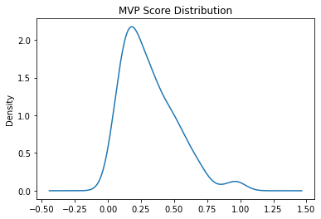
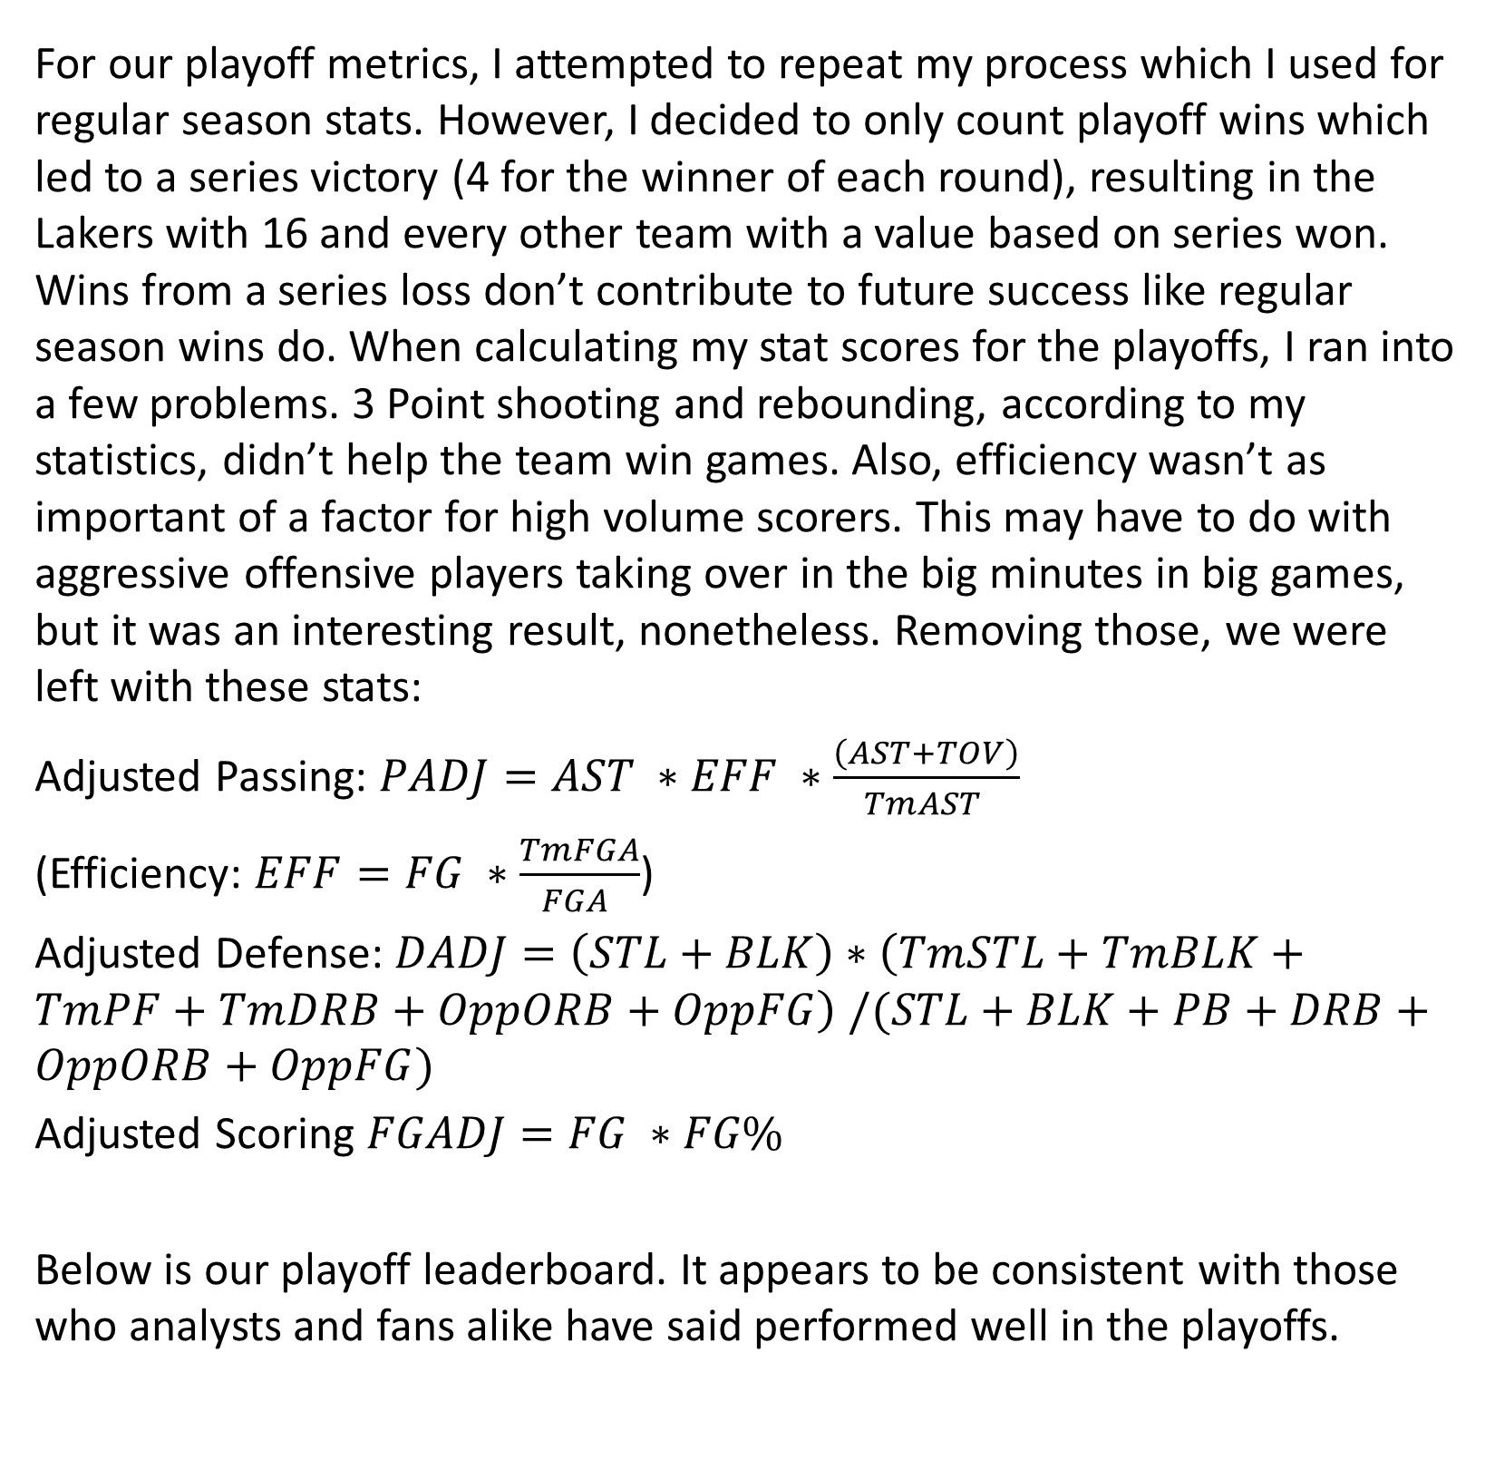
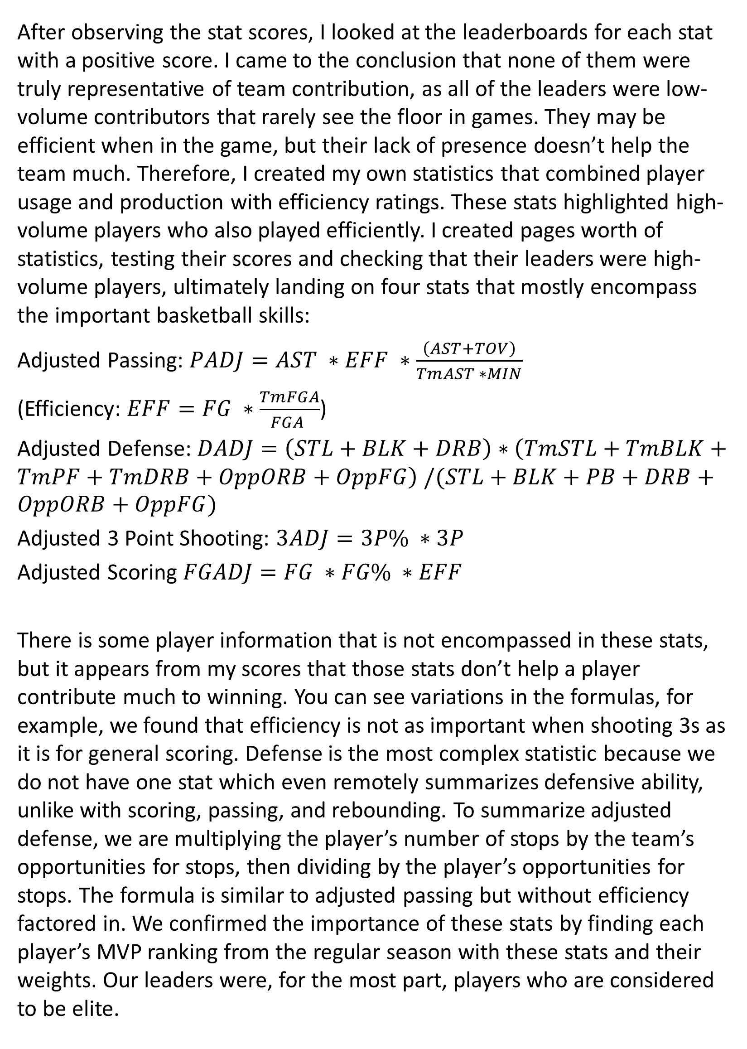
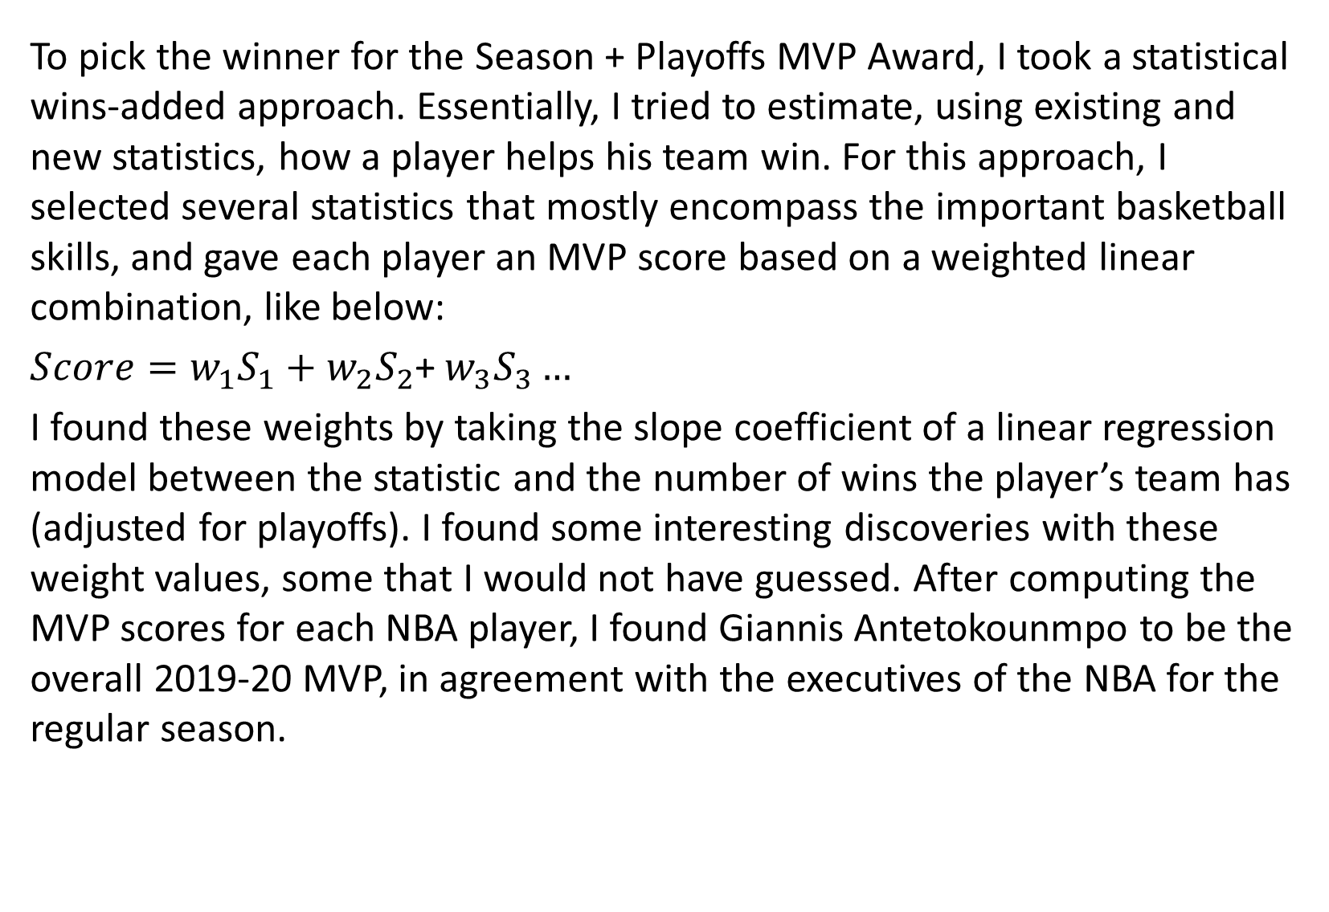
2019-20 Mickey Mouse MVP
Benjamin Zeman
University of Michigan - MSAS
MOTIVATION
WEIGHTS
PLAYOFFS
RESULTS
The goal of this study was essentially to fill in the holes that the NBA Executives left open when determining the MVP award for this past season. First, the award did not consider the 8 games that 22 teams played in the Orlando bubble or the playoffs. Since every team’s goal is to win a championship, with piling up stats coming second, I figured there should be a player who is honored for his work during the regular season, the bubble, and the playoffs. The bubble games are effectively more important that the earlier games, since these games ultimately decide playoff seeding. Also, strong playoff performance can help a team win a title and make up for lower seeding caused by poorer play in the regular season.
As we all know, not all statistics are created equal. Therefore, when evaluating a player’s overall performance, we can’t just take the sum of the important statistic. I decided to look at each statistic and determine how valuable it is. My method for accomplishing this was finding how much of a change in that player’s statistic value results in an extra win for his team. The simplest was to do this was to perform a Least-Squares linear regression for each statistic and the player’s win total. I found the slope coefficient for each statistic, and I will refer to it as the “score” of the statistic. When focusing on regular season statistics, I found some interesting scores.
This diagram effectively confirms the devaluation of counting stats (those that aren’t a proportion) which many basketball analysts have been pushing for years. The theory is that counting stats don’t show how often you convert on your opportunities, and it could mean you are taking opportunities away from more efficient players. The negative score for offensive rebounds likely is derived from the fact that they come from long rebounds which tend to go hand in hand with poor shot selection.
For our playoff metrics, I attempted to repeat my process which I used for regular season stats. However, I decided to only count playoff wins which led to a series victory (4 for the winner of each round), resulting in the Lakers with 16 and every other team with a value based on series won. Wins from a series loss don’t contribute to future success like regular season wins do. When calculating my stat scores for the playoffs, I ran into a few problems. 3 Point shooting and rebounding, according to my statistics, didn’t help the team win games. Also, efficiency wasn’t as important of a factor for high volume scorers. This may have to do with aggressive offensive players taking over in the big minutes in big games, but it was an interesting result, nonetheless. Removing those, we were left with these stats:
Adjusted Passing: $PADJ=AST ∗EFF ∗\frac{\left(AST+TOV\right)}{TmAST }$
(Efficiency: $EFF=FG ∗\frac{TmFGA}{FGA }$)
Adjusted Defense: $DADJ=\left(STL+BLK\right)∗\left(TmSTL+TmBLK+TmPF+TmDRB+OppORB+OppFG\right) /(STL+BLK+PB+DRB+OppORB+OppFG)$
Adjusted Scoring $FGADJ=FG ∗FG\%$
Below is our playoff leaderboard. It appears to be consistent with those who analysts and fans alike have said performed well in the playoffs.
In the table below are the results that I found from this study. As you can see, Giannis Antetokounmpo is our MVP. It was relatively close between Giannis, LeBron, Harden, and Luka Doncic, with a sizeable gap between the rest of the field. As you can see from the score distribution, these players are significantly above the majority of players. The mean MVP score is only 0.313 with a standard deviation of 0.201. This means that the above group of players are over three standard deviations above the mean. Antetokounmpo is our MVP, but these four players all have a case to be the recipients of the award.
FG | -0.1494
3P | -0.13978
2P | -0.20079
FT | -0.32624
TRB | -0.04027
AST | -0.2731
STL | -1.83017
PROCESS OUTLINE
 | Player | Team | REG | PLYF | MVP
1 | Giannis Antetokounmpo | MIL | 0.773006 | 0.214745 | 0.987751
2 | LeBron James | LAL | 0.697714 | 0.280912 | 0.978627
3 | James Harden | HOU | 0.730199 | 0.229303 | 0.959503
4 | Luka Dončić | DAL | 0.661133 | 0.291145 | 0.952278
5 | Damian Lillard | POR | 0.736698 | 0.113298 | 0.849996
6 | Nikola Jokić | DEN | 0.5422 | 0.196433 | 0.738633
7 | Jayson Tatum | BOS | 0.556951 | 0.15428 | 0.711231
8 | Anthony Davis | LAL | 0.51447 | 0.192791 | 0.707261
9 | Donovan Mitchell | UTA | 0.486465 | 0.219391 | 0.705856
10 | Khris Middleton | MIL | 0.551984 | 0.129848 | 0.681832
To pick the winner for the Season + Playoffs MVP Award, I took a statistical wins-added approach. Essentially, I tried to estimate, using existing and new statistics, how a player helps his team win. For this approach, I selected several statistics that mostly encompass the important basketball skills, and gave each player an MVP score based on a weighted linear combination, like below:
$Score=w_{1}S_{1}+$ $w_{2}S_{2}$+ $w_{3}S_{3}…$
I found these weights by taking the slope coefficient of a linear regression model between the statistic and the number of wins the player’s team has (adjusted for playoffs). I found some interesting discoveries with these weight values, some that I would not have guessed. After computing the MVP scores for each NBA player, I found Giannis Antetokounmpo to be the overall 2019-20 MVP, in agreement with the executives of the NBA for the regular season.
STAT CREATION
Player | PLYF SCORE
Luka Dončić | 0.291144791
LeBron James | 0.280912066
James Harden | 0.229303217
Donovan Mitchell | 0.219390705
Giannis Antetokounmpo | 0.214744661
Jamal Murray | 0.199725348
Nikola Jokić | 0.19643296
Anthony Davis | 0.192791212
Nikola Vučević | 0.184181156
Chris Paul | 0.179447394
After observing the stat scores, I looked at the leaderboards for each stat with a positive score. I came to the conclusion that none of them were truly representative of team contribution, as all of the leaders were low-volume contributors that rarely see the floor in games. They may be efficient when in the game, but their lack of presence doesn’t help the team much. Therefore, I created my own statistics that combined player usage and production with efficiency ratings. These stats highlighted high-volume players who also played efficiently. I created pages worth of statistics, testing their scores and checking that their leaders were high-volume players, ultimately landing on four stats that mostly encompass the important basketball skills:
Adjusted Passing: $PADJ=AST ∗EFF ∗\frac{\left(AST+TOV\right)}{TmAST ∗MIN}$
(Efficiency: $EFF=FG ∗\frac{TmFGA}{FGA }$)
Adjusted Defense: $DADJ=\left(STL+BLK+DRB\right)∗\left(TmSTL+TmBLK+TmPF+TmDRB+OppORB+OppFG\right) /(STL+BLK+PB+DRB+OppORB+OppFG)$
Adjusted 3 Point Shooting: $3ADJ=3P\% ∗3P$
Adjusted Scoring $FGADJ=FG ∗FG\% ∗EFF$
There is some player information that is not encompassed in these stats, but it appears from my scores that those stats don’t help a player contribute much to winning. You can see variations in the formulas, for example, we found that efficiency is not as important when shooting 3s as it is for general scoring. Defense is the most complex statistic because we do not have one stat which even remotely summarizes defensive ability, unlike with scoring, passing, and rebounding. To summarize adjusted defense, we are multiplying the player’s number of stops by the team’s opportunities for stops, then dividing by the player’s opportunities for stops. The formula is similar to adjusted passing but without efficiency factored in. We confirmed the importance of these stats by finding each player’s MVP ranking from the regular season with these stats and their weights. Our leaders were, for the most part, players who are considered to be elite.
DATA
To perform my in-depth statistical analysis, I scraped data off of ESPN’s basketball stats library and the very popular BasketballReference. The team standings came from BR datasets separated by conference, while the team statistics came from an ESPN datasets. I also needed player stats from BR, playoff stats (Team and Player) from BR, and an abbreviation code to help join datasets. The merges were relatively messy, so some renaming of columns and team abbreviations was necessary. We were left with large dataset of over 100 columns, sorted by player, including player, team, and playoff statistics. Below is a small sampling of statistics. The missing values below are for players who didn’t make the playoffs. The playoff scores for these players will be 0.
SOURCES OF ERROR
REFERENCES
2019-20 NBA Player Stats: Per Game. (2020). Basketball-Reference.Com. https://www.basketball-reference.com/leagues/NBA_2020_per_game.html
2019-20 NBA Season Summary. (2020). Basketball-Reference.Com. https://www.basketball-reference.com/leagues/NBA_2020.html
2020 NBA Playoffs Stats: Per Game. (2020). Basketball-Reference.Com. https://www.basketball-reference.com/playoffs/NBA_2020_per_game.html
2020 NBA Playoffs Summary. (2020). Basketball-Reference.Com. https://www.basketball-reference.com/playoffs/NBA_2020.html#all_team-stats-per_game
ESPN: Serving sports fans. Anytime. Anywhere. (2020). ESPN.Com. https://www.espn.com/nba/stats/team
Wikipedia contributors. (2020). Wikipedia:WikiProject National Basketball Association/National Basketball Association team abbreviations - Wikipedia. Wikipedia. https://en.wikipedia.org/wiki/Wikipedia:WikiProject_National_Basketball_Association/National_Basketball_Association_team_abbreviations
Like in any research project, there are plenty of ways that my methods could lead to error. The largest source of error in this project, in my opinion, is the calculation of stat scores. I used linear regression, which generates error when the correlation between the two variables is not exactly linear. I did not confirm that each stat increased linearly with wins, only that it increased with wins. Another source of error comes from joining datasets. I attempted to clean up the data as much as possible, but it is likely that there is some form of mistranslation of data which is still present. Finally, the statistics were often rounded to three significant figures. This can cause massive rounding error when performing calculations. If I were to do this project again, hopefully with more time, I would analyze each stat/wins correlation and make a nonlinear model if necessary. I would also try to scrape all data from one or two tables to minimize merging error. I could also find data with more exact numeric values. Not all of these may be possible, but I could attempt to correct these error sources.
Player | Tm | 3P | ORB_PLYF | AST_TEAM | TRB_PLYF_TEAM
Steven Adams | OKC | 0 | 4.9 | 22.8 | 49.9
Bam Adebayo | MIA | 0 | 2.5 | 25.9 | 41.3
LaMarcus Aldridge | SAS | 1.2 |  | 24.4
Kyle Alexander | MIA | 0 |  | 25.9 | 41.3
Nickeil Alexander-Walker | NOP | 1 |  | 26.2
Grayson Allen | MEM | 1.5 |  | 26.6
Jarrett Allen | BRK | 0 | 4.3 | 26.4 | 44.3
Kadeem Allen | NYK | 0.5 |  | 21
Al-Farouq Aminu | ORL | 0.5 |  | 22.7 | 43
Justin Anderson | BRK | 0.6 | 0 | 26.4 | 44.3
FUTURE RESEARCH
As I mentioned earlier, examining statistics that correlate with wins non-linearly, and expressing the score as a function of the team’s wins, could provide a more in-depth analysis regarding how much a player contributes to his team. I could also look more into the distribution of stat scores shown above and use it for statistical simulation. Instead of looking solely at last year, I could predict future MVPs based off of statistical changes. I could use the distribution to compare one player’s projection to another. There are several ways I could continue my research, so I hope the opportunity comes for me to do so!

